Slide 1
Geometric Data Analysis Group
Department of Statistics, University of Washington
(Autumn 2024 Introduction)

Slide 2
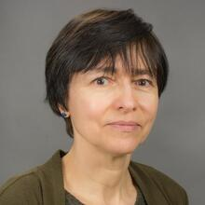
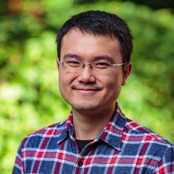
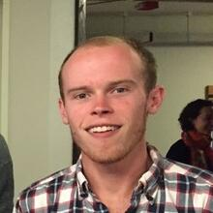

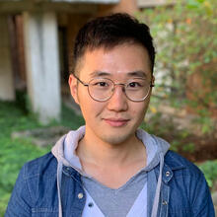

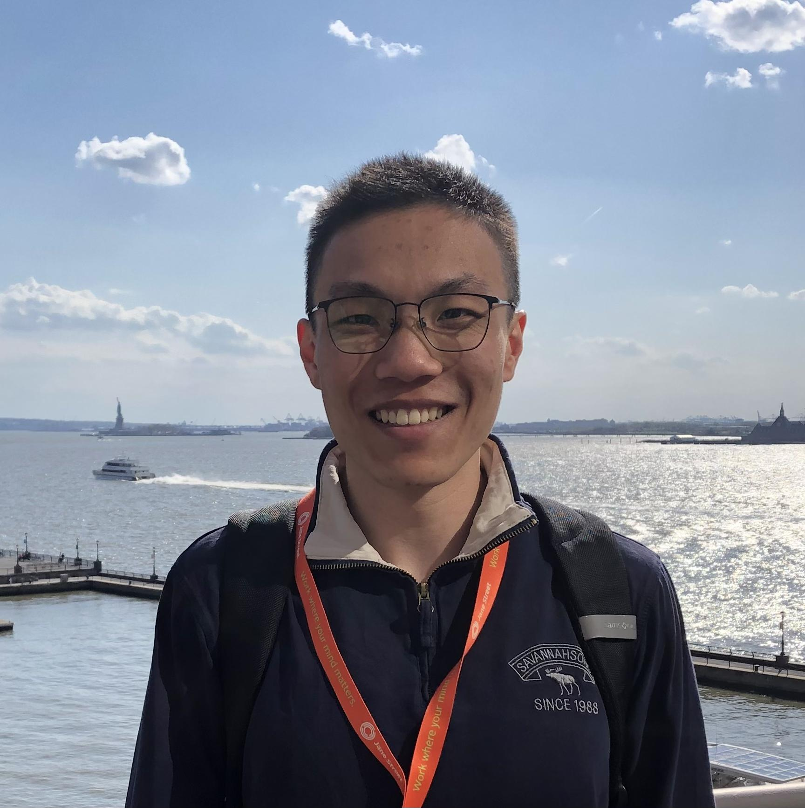
History of the GDA Group
The Geometric Data Analysis (GDA) group was founded in Fall 2017 by our faculty members (old website):
Professor Marina Meila
Professor Yen-Chi Chen
Previous and current student organizers include (current website):
Samson Koelle
(graduated in 2022)
Hanyu Zhang
(graduated in 2023)
Jerry Wei
(graduated in 2024)
James Buenfil
(5th-year PhD student)
Yikun Zhang
(3th-year PhD student)

Slide 3
What Are We Interested In?
The topics of our research interests in Geometric Data Analysis include but not limited to:
Topological data analysis.
Manifold learning algorithms -- are they "correct"? How to detect and remove algorithmic artefacts.
Higher order Laplacians and the analysis of vector fields on manifolds.
Interpretable manifold coordinates.
Nonparametric statistics on Riemannian manifolds.
Optimization on smooth manifolds.
etc…
More details can be found on our current website: https://uwgeometry.github.io/.

Slide 4
Other Logistics
We will meet biweekly from 5pm to 6pm on Mondays at CSSS or C301 conference room in Padelford Hall.
No prerequisites are required for attending the reading group. Everyone is welcome to join!
For student participants: if you plan to volunteer for a presentation or leading a discussion, you can sign up for one stat 600 credit with one of the faculty organizers.
Potential paper list for presentations (link).
You can add yourself to the group mailing list at https://mailman12.u.washington.edu/mailman/listinfo/geometry.

Slide 5
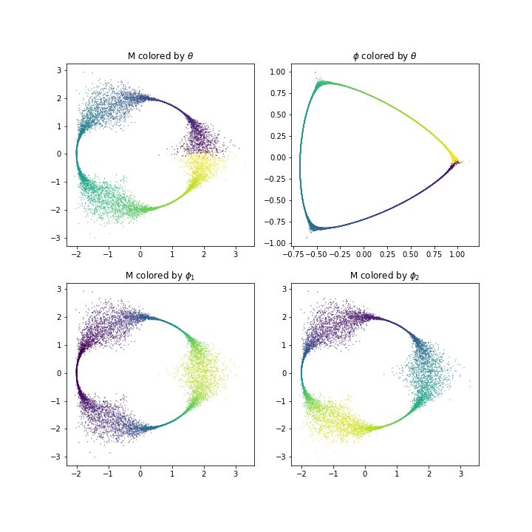
Questions or Concerns?
Let’s do some self-introductions:
For current group members, please also give a short introduction to your research interests.
For new student members, please feel free to introduce your name, year, program, and some academic background or previous research experiences.

